Slide 1
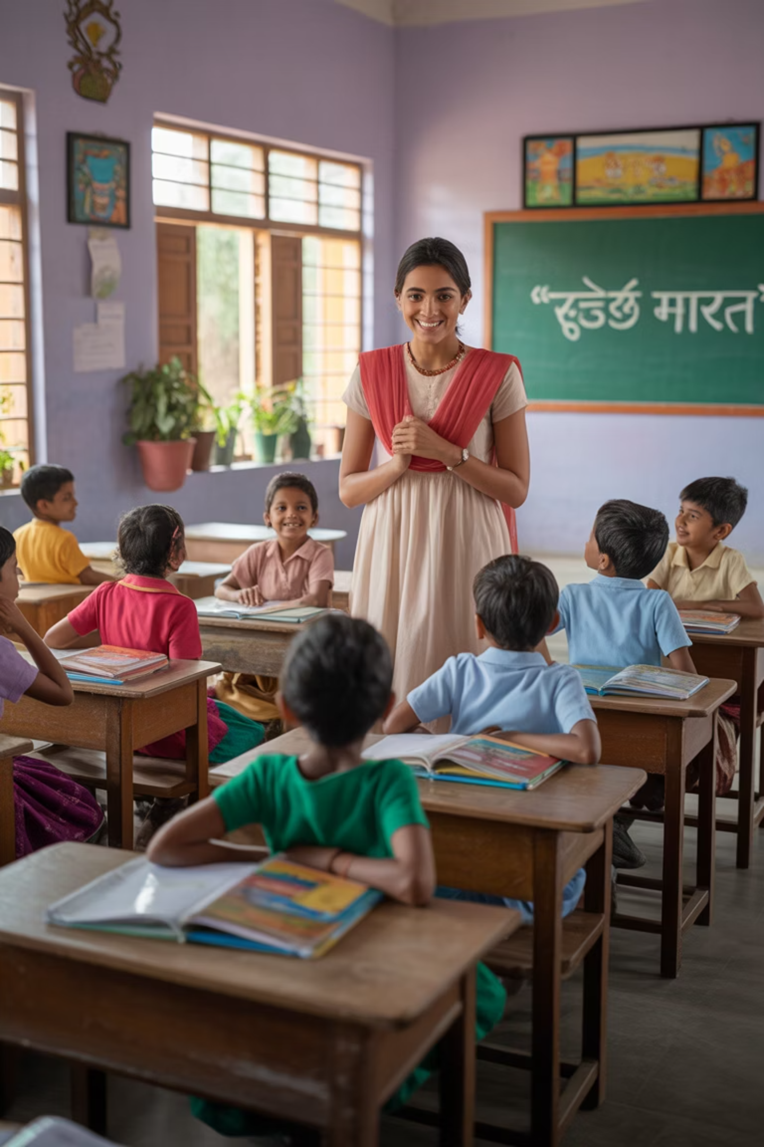
Partnering for Impact: XYZ NGO's Work & Vision
A proposal submitted to [Corporate Name]
Date: [DD/MM/YYYY]

Slide 2
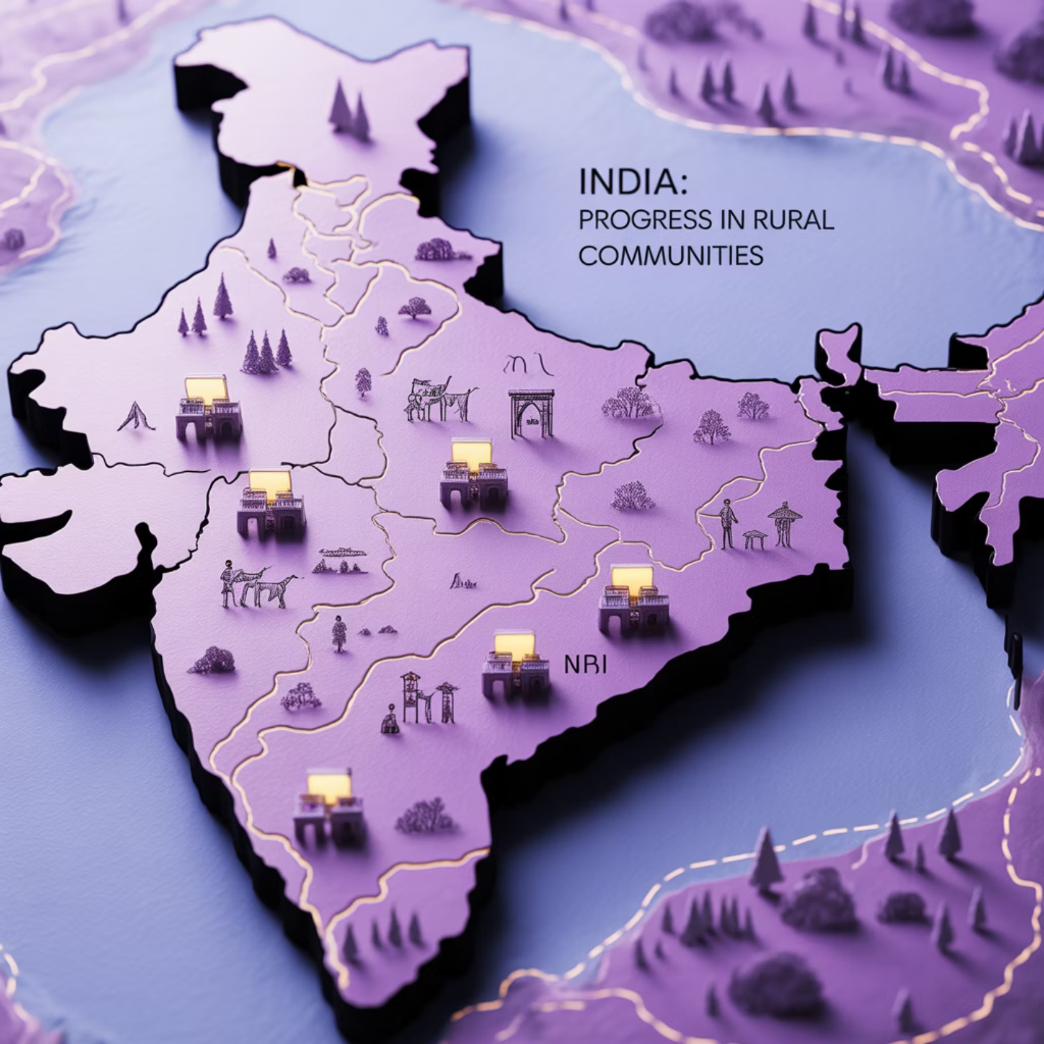
Introduction to XYZ NGO
Founded in 2010, XYZ NGO works toward creating a just and inclusive society by empowering rural youth through education and skills development initiatives.
Our organization has established a significant presence across 8 states and 52 districts in India, focusing on areas with the greatest need.
As a registered Society with all necessary certifications (CSR-1, FCRA, 12A, 80G), we maintain the highest standards of compliance and transparency.

Slide 3
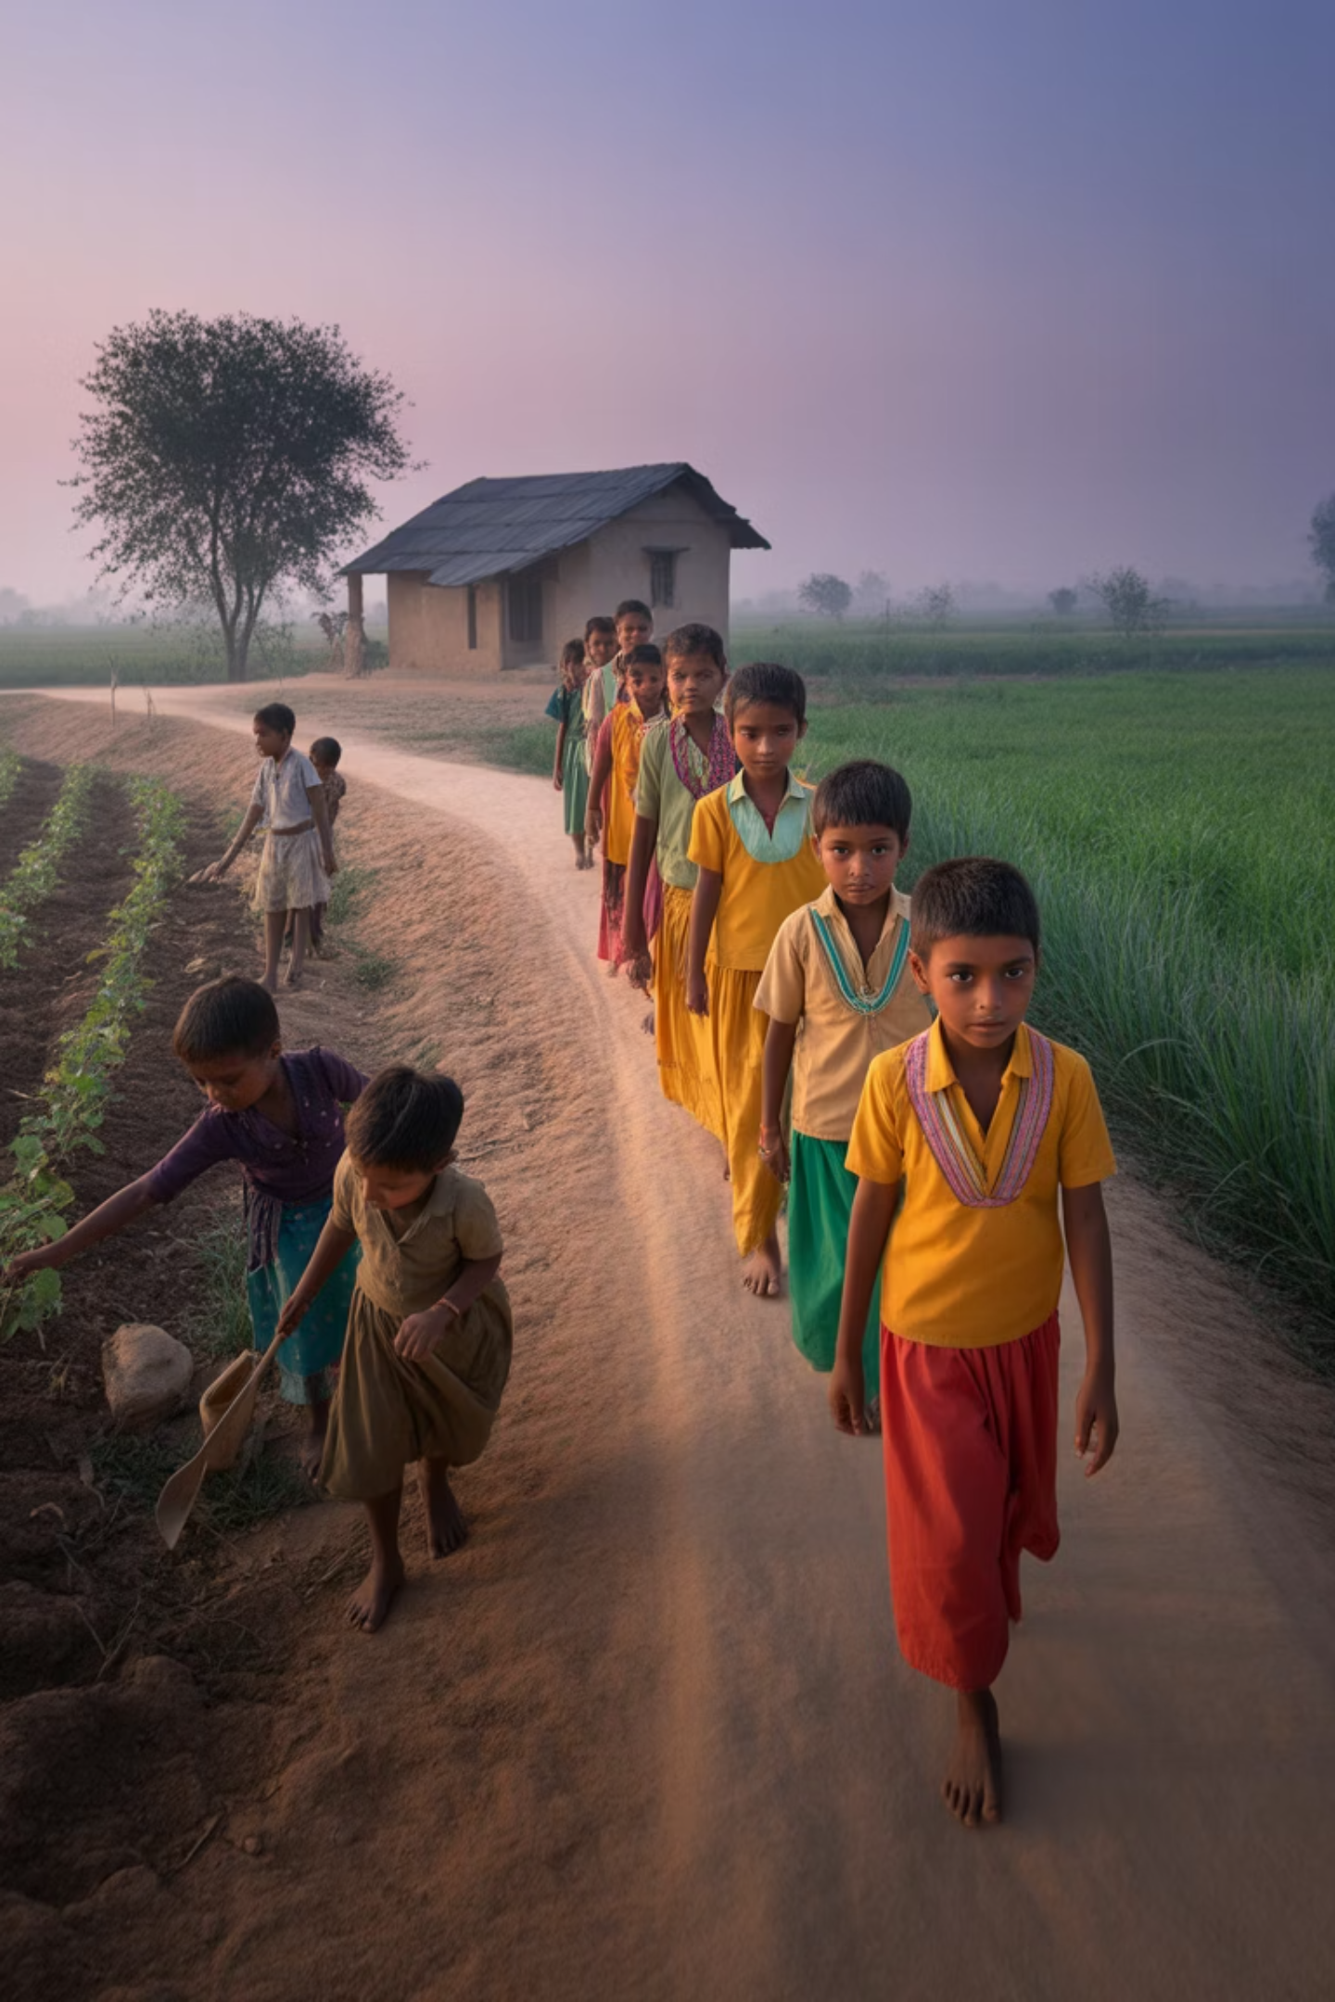
The Problem We Address
School Dropouts in Tribal Regions
Alarming Statistics
According to U-DISE 2023 data, rural India faces a staggering 48% dropout rate, leaving thousands of children without basic education and future opportunities.
Our core focus is addressing the critical issue of school dropouts in tribal regions across India, where educational infrastructure and access remain significant challenges.
Strategic Alignment
Our work directly aligns with the National Education Policy and Sustainable Development Goal 4 (Quality Education), making it a priority area for intervention.

Slide 4
Our Programs & Interventions
1
2
3
Project Shiksha
Project Udaan
Project Swavlamban
Bridge Education Program designed specifically for school dropouts, helping them return to mainstream education through specialized curriculum and support.
Comprehensive life skills development program for adolescent girls, focusing on building confidence, decision-making abilities, and awareness of rights.
Livelihood training initiative offering skills in tailoring and agri-entrepreneurship, creating pathways to financial independence.
All our programs are strategically aligned with SDGs 4 (Quality Education), 5 (Gender Equality), and 8 (Decent Work and Economic Growth).

Slide 5

Impact So Far
12,000
1,500
38
Children Mainstreamed
Youth Trained
Learning Centers
In various vocational skills leading to employment
Community-based education hubs established
Successfully reintegrated into formal education system
82%
Placement Rate
Of youth trained successfully employed

Slide 6

Success Stories
Rekha, 16
Once a school dropout, Rekha is now a tailoring trainer earning ₹10,000 monthly, supporting her family and inspiring other girls in her village.
Sameer, 14
After three years out of school, Sameer returned through our bridge program and is now successfully studying in Class 8, with aspirations to complete his education.
"This NGO saved my daughter's future."
— Rekha's mother

Slide 7



Alignment with Corporate CSR Priorities
Corporate CSR Goal
XYZ NGO's Focus
Perfect Fit
Youth empowerment and skilling initiatives that create lasting impact in underserved communities
Rural skill building and women empowerment programs with proven methodologies and community acceptance
Scalable models, demonstrated impact metrics, and established access to hard-to-reach rural communities

Slide 8
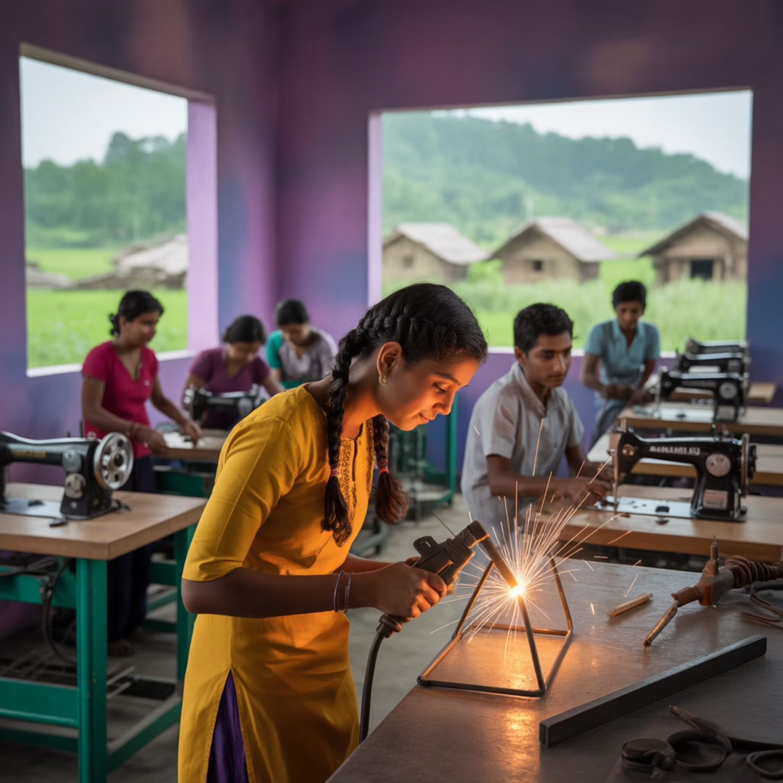
Proposed Collaboration
2-Year Skill Development Program
Implementation in 3 tribal districts with high dropout rates
Target beneficiaries: 3,000 youth (60% women)
Focus on market-relevant skills with employment potential
Methodology
Community mobilization and selection
Residential training with certified curriculum
Placement support and 12-month tracking

Slide 9








Budget & Resource Requirements
Training Infrastructure
Trainers
40% of budget (₹48 lakhs)
30% of budget (₹36 lakhs)
Equipment and materials
Skilled instructors
Training facilities
Subject matter experts
Administration
M&E
15% of budget (₹18 lakhs)
15% of budget (₹18 lakhs)
Program management
Impact assessment
Operational costs
Reporting systems
Total budget: ₹1.2 Cr with XYZ NGO contributing 10% in kind (training kits and trainers)

Slide 10

Monitoring, Evaluation & Reporting
1
Baseline Survey
Comprehensive assessment of current skill levels, educational status, and aspirations of target beneficiaries before program initiation
2
Monthly MIS Reporting
Regular data collection and analysis through our digital monitoring system, with dashboards accessible to CSR partners
3
Quarterly Field Visits
Facilitated visits for CSR team members to witness program implementation and interact directly with beneficiaries
4
Third-Party Social Audit
Independent evaluation at project conclusion to verify outcomes and document learnings for future scaling

Slide 11

Our Team & Governance
Leadership
Governance & Compliance
CEO with 15+ years in development sector
Active board with quarterly oversight meetings
Program Head: Former UNDP consultant with extensive field experience
Annual audits conducted by Big 4 CA firm
Transparent financial management systems
Team Structure
Regular statutory compliance reviews
35 full-time professional staff
50+ trained field facilitators from local communities

Slide 12

Past Donors & Collaborations
CSR Partners
Government Collaborations
Tata Power
Ministry of Skill Development
Infosys Foundation
Ministry of Tribal Affairs
Vedanta
State Education Departments
90% retention rate among CSR partners, demonstrating satisfaction with our implementation and reporting.
Recognition
Regional Winner of the prestigious India NGO Awards 2022, recognizing excellence in impact, governance, and innovation.

Slide 13
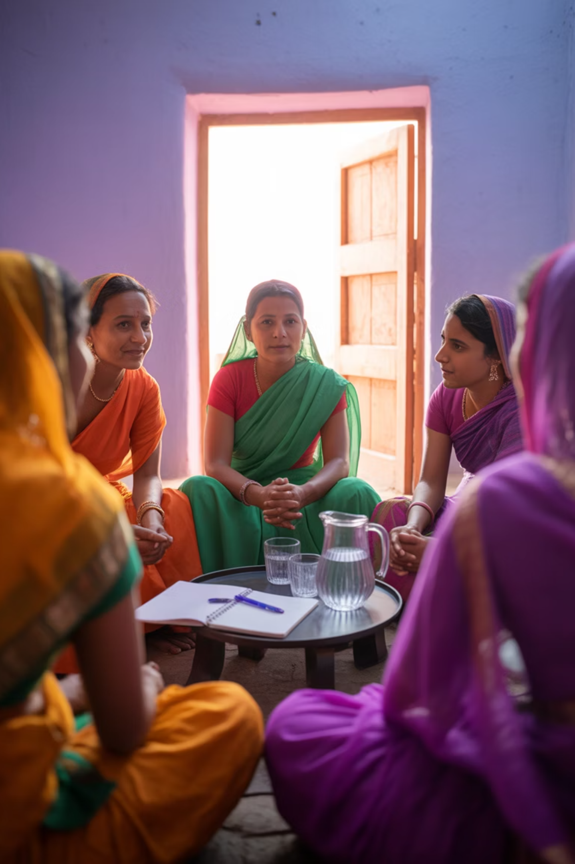
Sustainability & Exit Strategy
Community Leadership
We identify and train local community leaders who can continue running programs after our formal exit, ensuring knowledge transfer and ownership.
Women-Led SHGs
Formation of Self-Help Groups led by women who maintain skill development initiatives and create micro-enterprises to sustain impact.
Curriculum Integration
Local schools adopt our bridge curriculum and methodologies, institutionalizing the approach within existing educational systems.

Slide 14




Why Partner with XYZ NGO?
Local Presence
Community Trust
Established networks in hard-to-reach tribal and rural geographies where few organizations have sustained presence.
Deep relationships with local communities and government stakeholders built over 13 years of consistent engagement.
Digital M&E Tools
Partner Retention
Advanced monitoring systems providing real-time data on program implementation and impact metrics.
90% of our CSR partners continue funding beyond initial project periods, demonstrating satisfaction with outcomes.

Slide 15


Call to Action
Our Request
Contact Information
We are seeking ₹1.2 Cr in CSR funding support over a 2-year period to implement our comprehensive skill development program across 3 tribal districts.
Ms. Neha Gupta
Next Steps
Program Director
Joint planning session with your CSR team
neha@xyzngo.org
MoU signing and documentation
+91-XXXXXXXXXX
Program kickoff within 45 days of approval

